Slide 1

Instrumentation and Control
CSE 325
What you cannot avoid, just welcome it
- Chinese Proverb
Mehedi Hasan
Lecturer
Computer Science and Engineering(CSE)
Daffodil International University(DIU)

Slide 2
Measurement of Pressure
Pressure
Pressure is the normal force per unit area exerted by a fluid (liquid or gas) on a surface (usually the walls of the container).
Pressure acts perpendicular (normal) to the surface.
Pressure is not a vector quantity; it is a scalar, meaning it has magnitude only and no direction
Types of Pressure
There are three commonly used types of pressure:
Absolute Pressure Absolute pressure is the actual pressure measured relative to a perfect vacuum, where pressure is zero.
2. Gauge Pressure Gauge pressure is the difference between the measured pressure and the atmospheric (ambient) pressure.
3. Differential Pressure Differential pressure is the difference between two pressure points, where one point is taken as a reference. Even if both pressures change, the difference between them is what matters.

Slide 3
Electro-Mechanical Pressure Measurement
These instruments use both mechanical and electrical methods to measure pressure.
Mechanical part → senses (detects) the pressure
Electrical part → shows or records the pressure
Main Components
These instruments need two main parts:
Sensing Element
Electrical Transducer
Because of this combination, they are called secondary transducers.
A transducer is a device that converts energy from one form into another
Sensing Element
known as a force-summing device
Its job is to detect pressure
It converts pressure into mechanical movement (displacement)
In simple terms: Pressure → turns into movement
Electrical Transducer
It receives the movement from the sensing element
Converts that movement into an electrical signal
This signal is then used for measurement or display.
In simple terms: Movement → turns into electrical signal

Slide 4
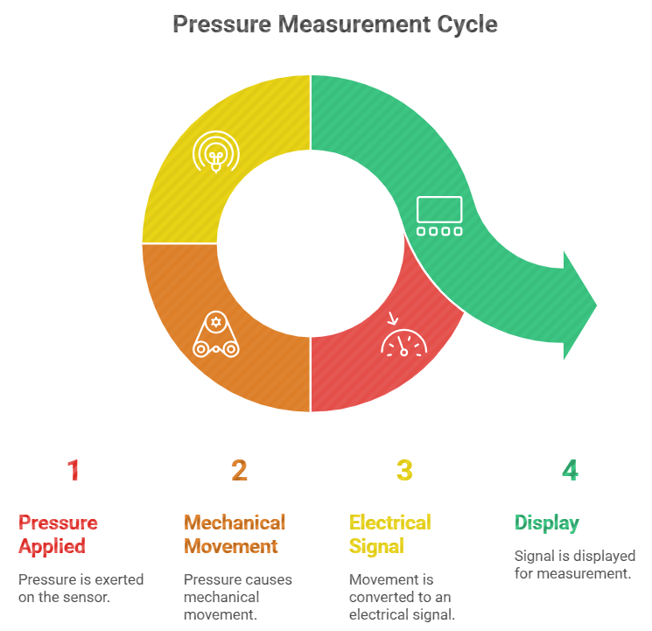
Electro-Mechanical Pressure Measurement
Pressure → Mechanical Movement → Electrical Signal → Display

Slide 5
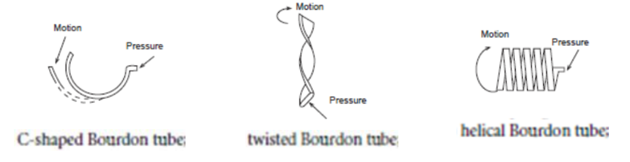
Electro-Mechanical Pressure Measurement
Sensing element:
must be made of an elastic material and must operate within its elastic limit
The stresses produced in the sensing element establishes equilibrium with the pressure to be measured by a displacement of the element
The choice and design of the type of sensing element depends on the magnitude of pressure to be measured.
Secondary Transducers
various types of transducers are used
➢ Resistive,
➢ Inductive
➢ Capacitive
➢ Piezoelectric

Slide 6
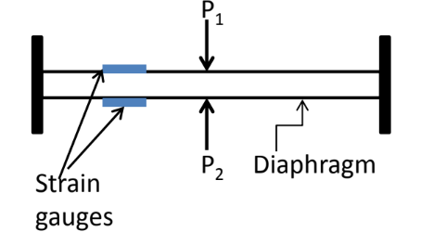
Resistive Pressure Transducer
Diaphragm-Strain Gauge pressure sensor
Sensing element: diaphragm
Transducer: strain gauge are attached to a diaphragm
e.g. Two strain gauges are attached on opposite sides of a diaphragm for differential pressure measurement
Working Principle
The process works step by step:
Differential Pressure → Diaphragm Deflection → Strain Difference → Electrical Output
When pressure is applied, it causes the diaphragm to bend (deflect)
This bending creates a difference in strain in two strain gauges
The strain difference is converted into an electrical signal

Slide 7
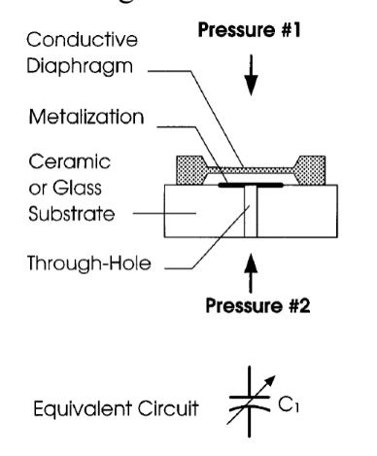
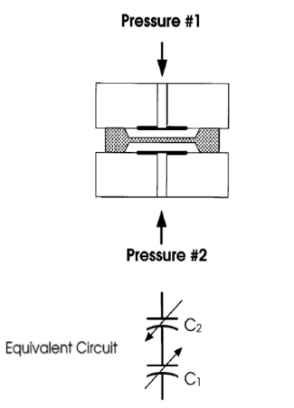
Capacitive Pressure Transducers
Highly accurate pressure sensors of today use capacitive detection technique
Ex: Diaphragm – Capacitive pressure sensor
• Sensing element: diaphragm
• Transducer: Capacitive
Pressure diaphragm movement change in distance between plates
Option 1: single capacitor design Option 2: Differential capacitor design

Slide 8
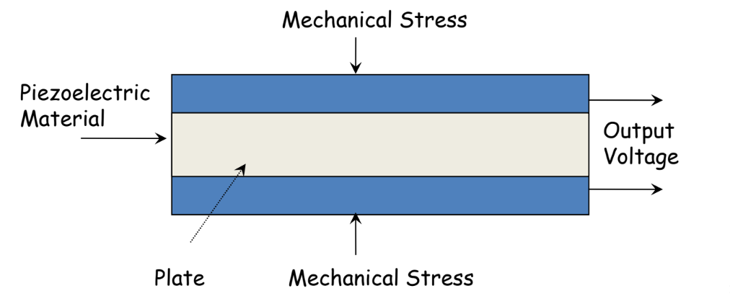
Piezoelectric Pressure Transducers
This is a primary pressure transducer; NO force summing device is needed
• Piezoelectric crystal (made from quartz): converts mechanical stress applied to it into voltage.
• Pressure exerted on the crystal surface is proportional to the voltage produced by the crystal.
• No voltage supply is required. It produces voltage.
• Suitable for fast-changing pressure measurement.

Slide 9
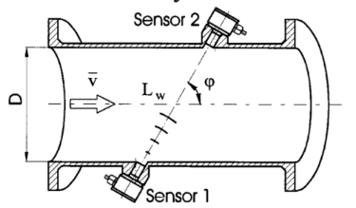
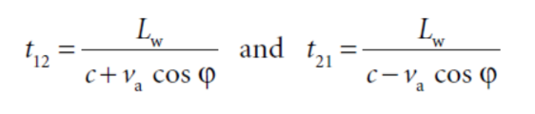
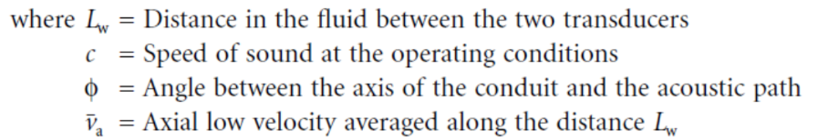
Measurement of Flow
Ultrasonic Flowmeter
Various types of ultrasonic flowmeters are there for flow/discharge measurement
• Most widely used type is the Transit Time type Transit time type
Operating principle:
• makes use of the difference in the time for an ultrasonic pulse to travel a fixed distance, first against the flow and then in the direction of flow.
• the propagation velocity of an acoustic wave and the flow velocity are summed vectorially.
The two transmit times (t12 and t21) of acoustic pulses are given by:

Slide 10
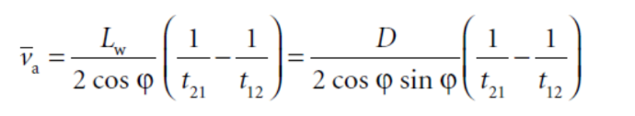
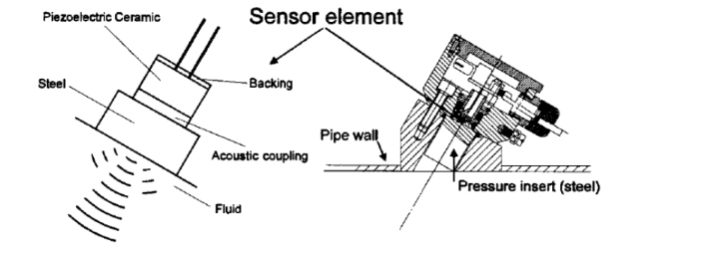
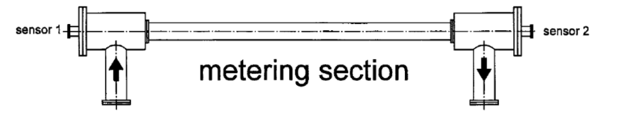
Measurement of Flow
The mean axial fluid flow velocity can be found as:
Sensors:
Transmitter and receiver both are made of piezoelectric crystals
Axial metering:

Slide 11
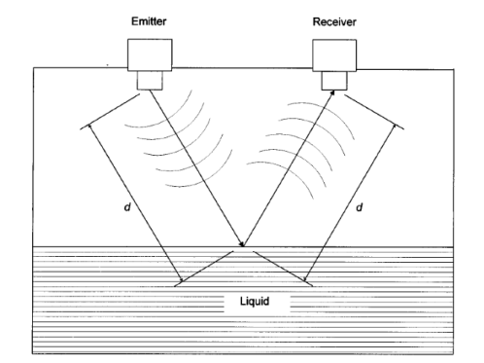
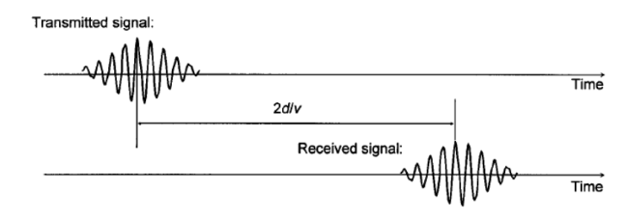

Measurement of Liquid Levels
Time-of-Flight Method
The measuring system evaluates the time-of-flight t of the signal:
Where v is the propagation velocity of the waves
The waves can be:
a. Ultrasonic: longitudinal acoustic waves; same/separate piezoelectric crystals can be used as emitter and receiver
b. Electro-magnetic: could be microwave, laser; wave generation and detection are performed by separate modules.

Slide 12
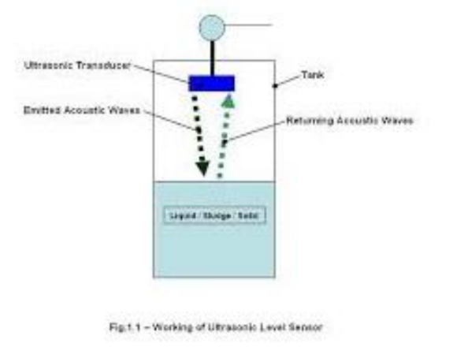

Measurement of Liquid Levels
Time-of-Flight Method
ultrasonic method:
Transit time is a measure of distance between top liquid surface and the ultrasonic transducer
d is the distance between top surface and transducer, H is fixed distance of transducer from the liquid bottom, h is the liquid height

Slide 13
দুনিয়াতে মাত্র ১০ ধরণের মানুষ আছে; যারা বাইনারি বোঝে, আর যারা বোঝে না। আমরা হচ্ছি ইঞ্জিনিয়ার কি বুঝি, কি বুঝি না! এটাই বুঝিনা... তাইতো কবিগুরু বলেছেন জানার শেষ যে কোথায়, তা জানা নাই।
“তোমারে যা দিয়েছিনু সে তোমারই দান গ্রহণ করেছ যতো ঋণী ততো করেছ আমায়। হে বন্ধু, বিদায়”-কবিগুরু

